Slide 1

ClauseEase
AI Chatbot
Presented By:-
Mudit Sharma
Presented To:-
Muvendiran Sir
(Mentor)

Slide 2
Now at first, like what are the need of this chatbot
and why to build it ???
Let’s start with the problem. We all know how powerful AI models like ChatGPT are. However,
in an enterprise environment like Infosys, we cannot simply upload sensitive internal documents
—like client contracts or project architectures—to a public cloud server due to data privacy and
security risks.
So here comes this project in the picture.

Slide 3
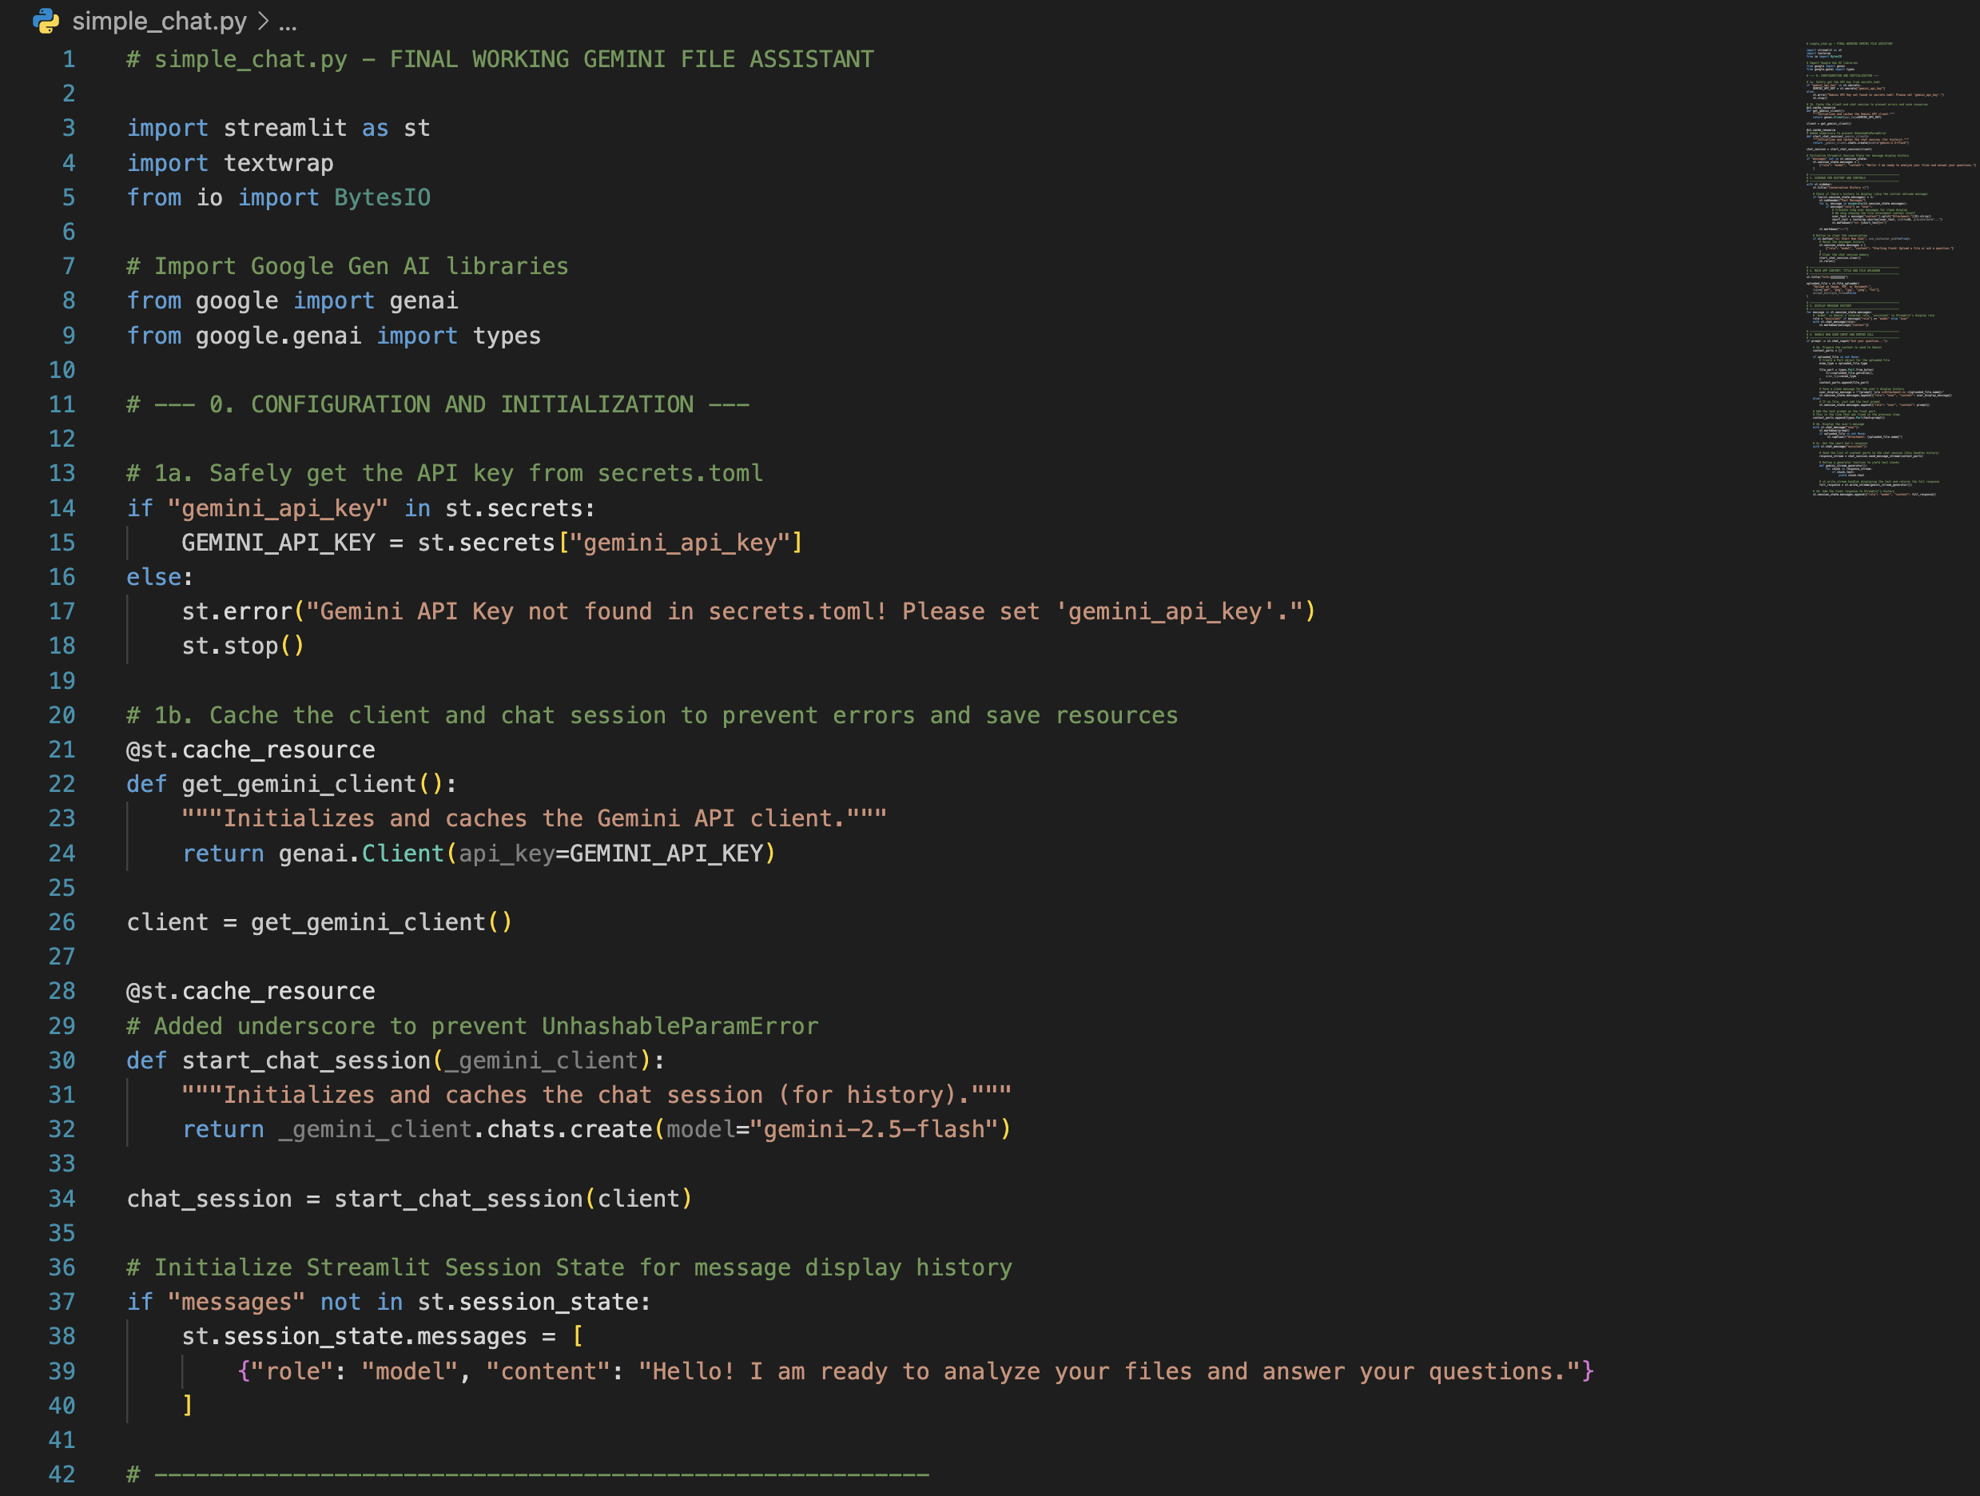
Behind the Scenes: My Chatbot Code

Slide 4
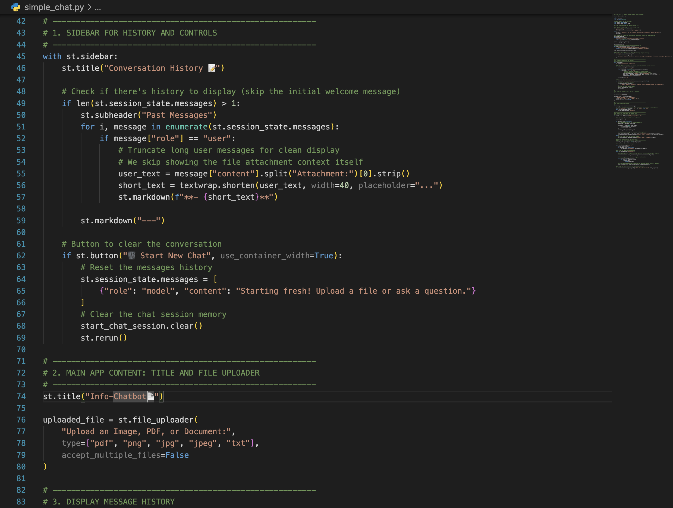

Slide 5
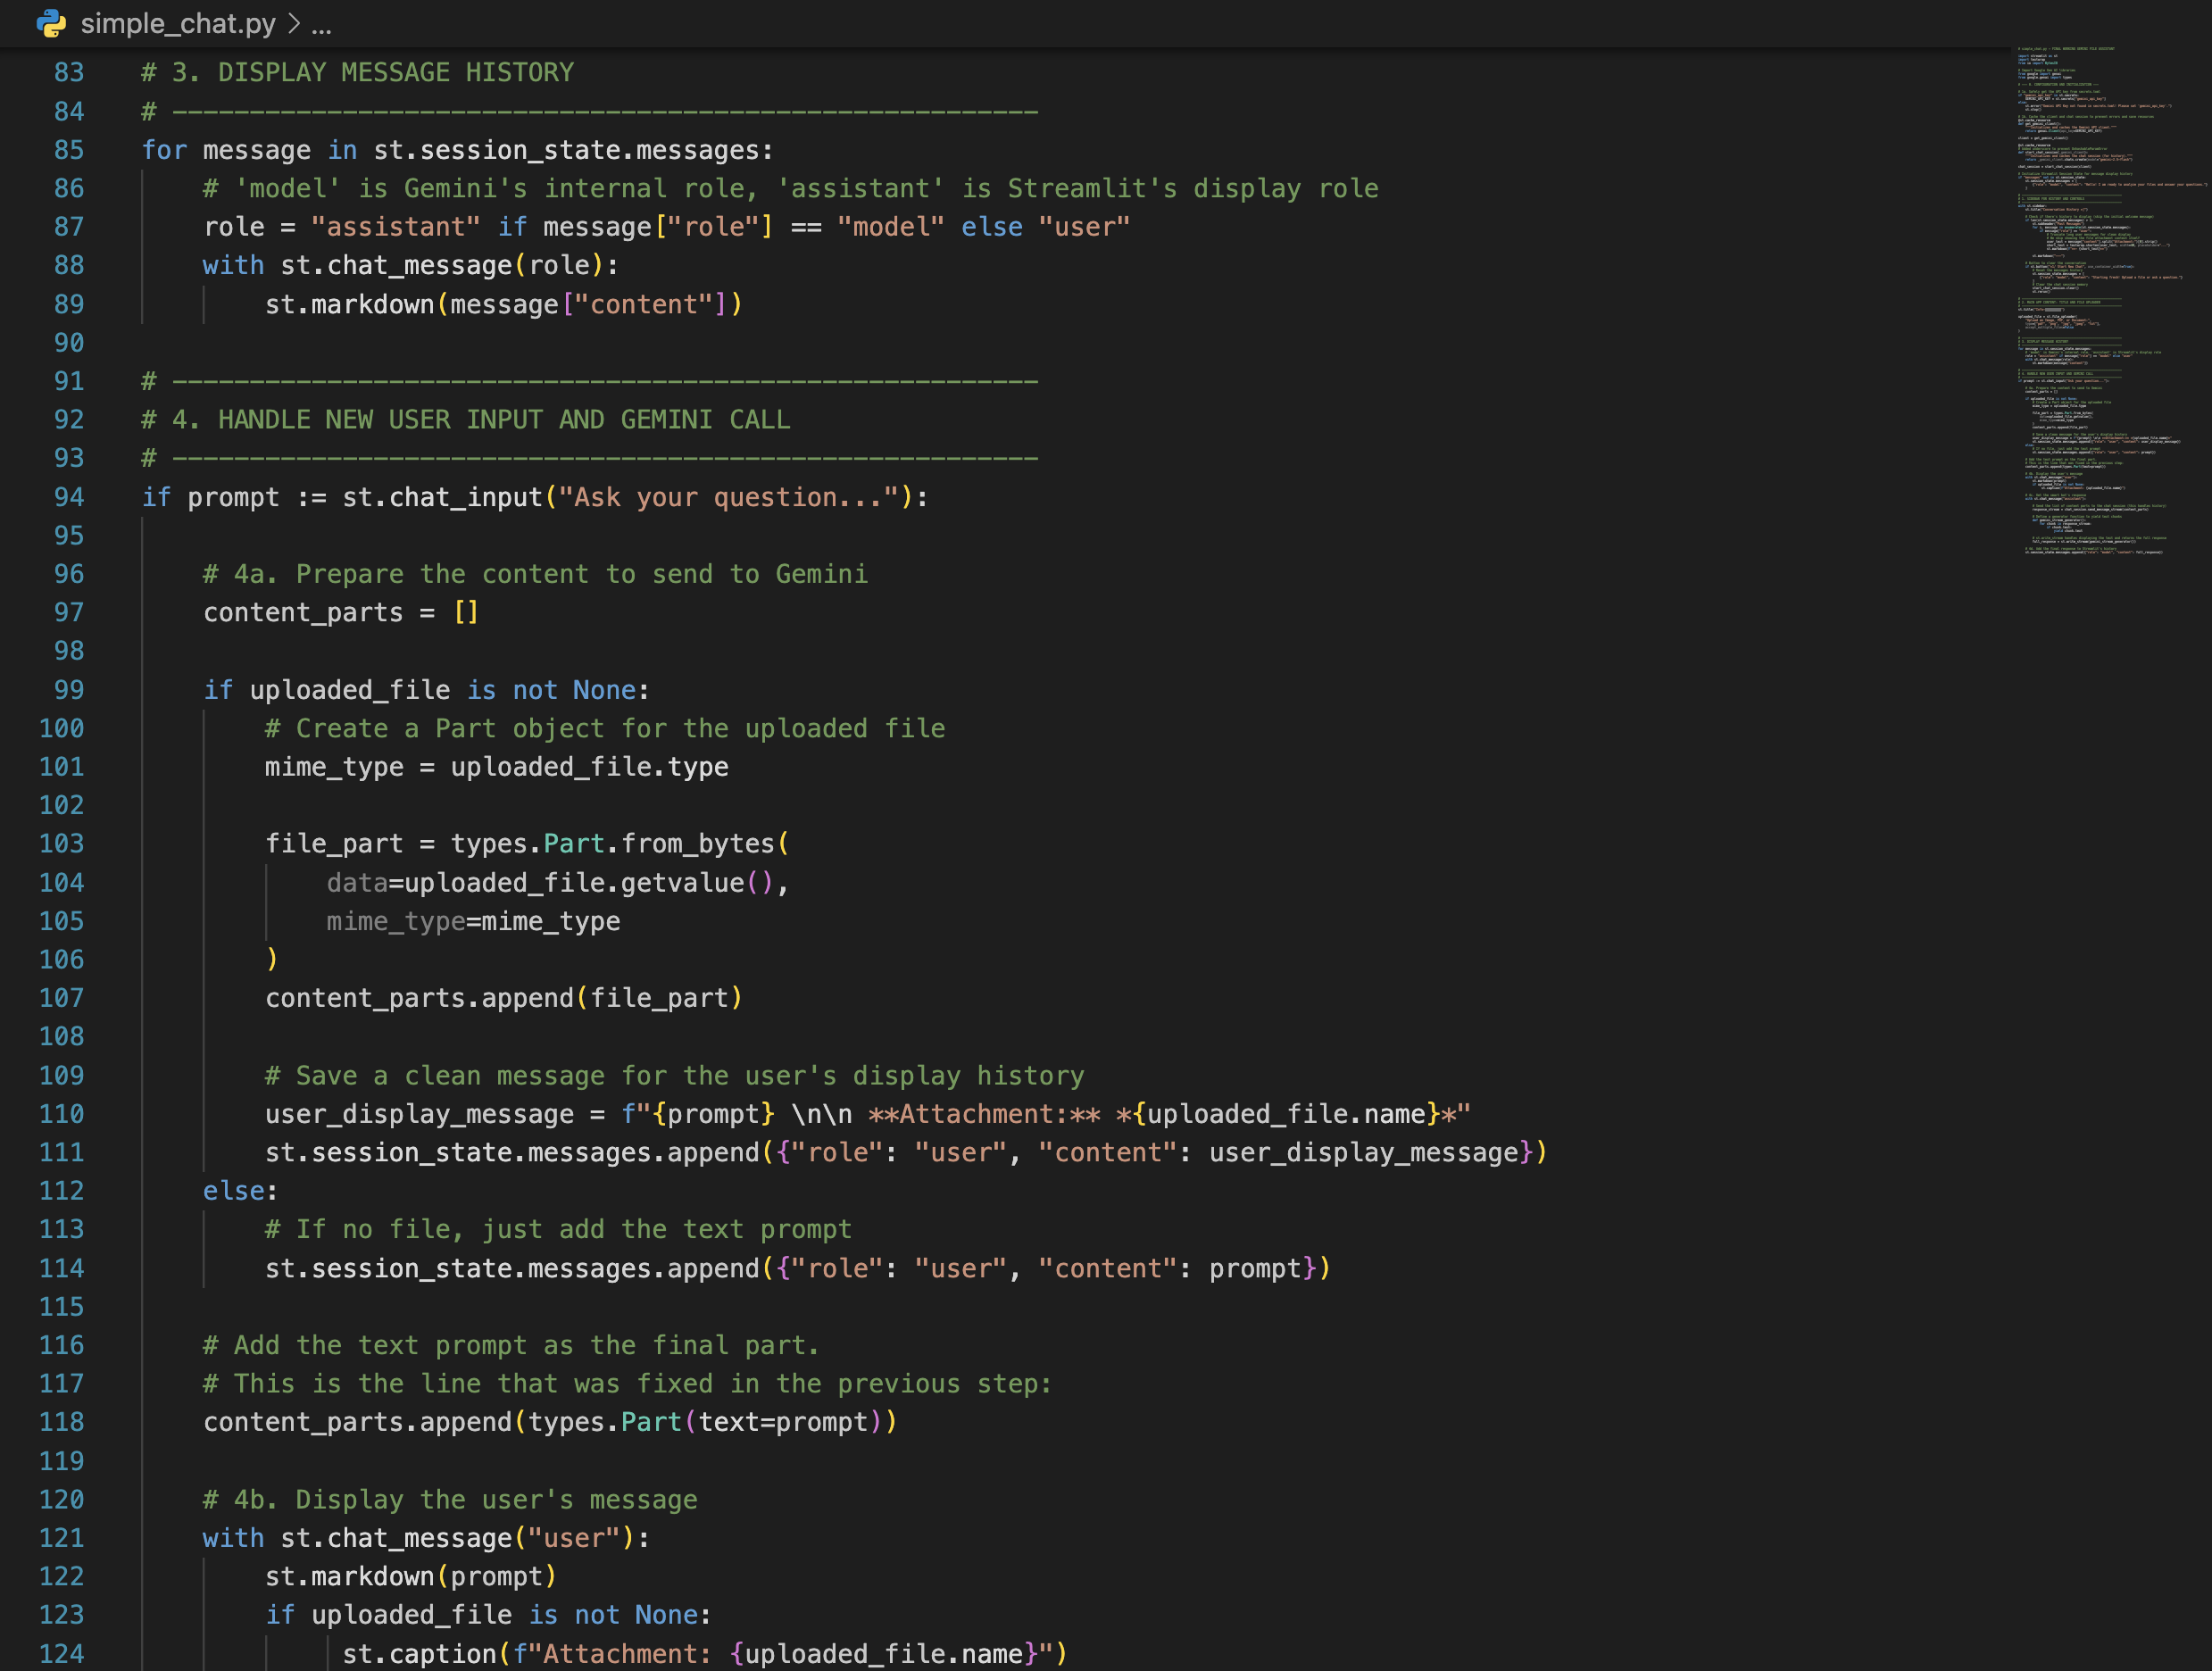

Slide 6
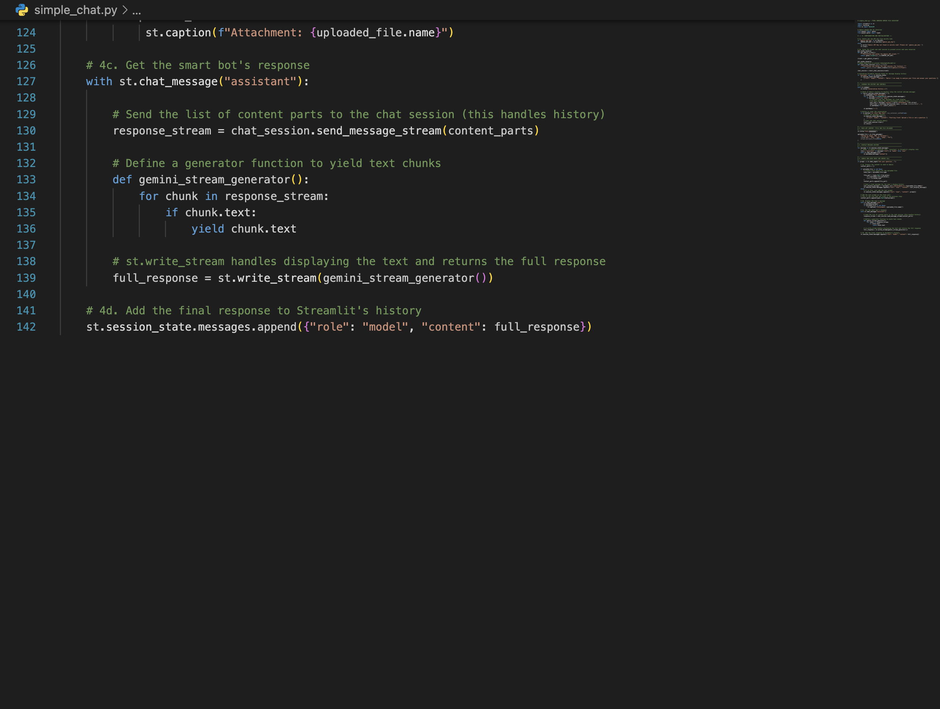

Slide 7

Till this, What I learned new !!??
I explored Streamlit to understand how web-based AI interfaces are
created. I used it to design and develop a Chatbot UI that interacts with
users in real time.

Slide 8
Now we know that LLMs have token limit, so we have to redesign our chatbot
Restructuring our Chatbot !!

Slide 9
Let’s Start with Chunking !!
Chunking in chatbots means breaking large pieces of text into smaller, manageable parts
(chunks) so that the chatbot can understand, store, and retrieve information more accurately.
Models (LLMs) have a token limit.
If you give it a long document (PDF, article, book chapter), the model cannot process all of it
at once.
So we split the document into small chunks, like:
300–500 words
or based on sentences/paragraphs
or fixed token size (e.g., 256 tokens per chunk)

Slide 10
Now Chunking is one thing, and there are other technologies also, so
let’s move onto the technology stack.
Technology Stack
Frontend (UI): Streamlit - For a simple, interactive web interface in Python.
AI Model Server: Ollama - For running Large Language Models (LLMs) locally.
LLM: Llama 3 (by Meta) - For generating human-like answers.
Vector Database: ChromaDB - For storing and searching document content.
PDF Processing: PyPDF - For extracting text from documents.
Language: Python - The core programming language for all logic.

Slide 11
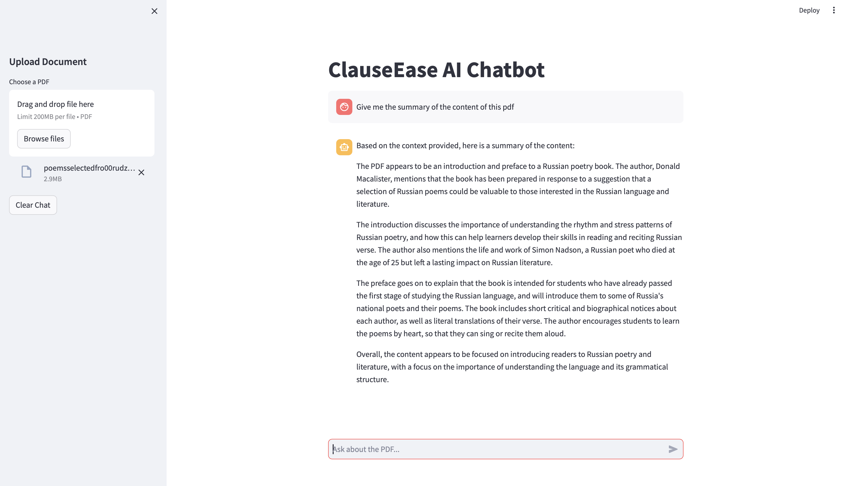
Output (Chatbot-UI) !!

Slide 12
Overall Project Takeaways
I gained hands-on experience of using streamlit, to build fully interactive web applications
Purely with python without using Html and CSS, learned how to design clean and responsive UIs.
Learned the importance of virtual environments and how to debug complex dependency errors.
Learned about LLMs and we can use them to integrate it in our chatbot.
This gave me a much deeper understanding of the underlying logic of chunking, embedding, and
retrieval, rather than just relying on a black-box function.

Slide 13
Thank you

